Slide 1
Kifer Tags
Steve Gallagher

Slide 2
Overview
Tags can be read when the cartridge is inserted into the instrument
Each tag has a unique tag ID and 128 bytes of read/write storage
The tag has no human readable information
The tag will be completely hidden under the cartridge cover

Slide 3
Unique Tag ID
A number unique to all tags of this class similar to a MAC address in network devices
Seven read only bytes
Display as 14 character ASCII HEX string
Example tag ID: 048f2961a28bf2

Slide 4
Tag Information 128 bytes
(Size in bytes)
Information Format (1)
Cartridge Type: Size, IEF Abs, or IEF Fluor (1)
Expiration Date (4)
Serial Number (10 ASCII digits 5)
Guaranteed Injection Count (1)
Injection Count Limit (1)
Max number of batches (1)
Max period from first to last batch (days 2)
Size injection gel limit (1)
Batch Date (4) x20
Batch Count (1) x20
CRC (2)
Total 119 bytes
Notes
Information Format is used to support future changes to the format
The CRC may be needed to guarantee no errors in the information
All dates are UTC seconds: 3/25/2011 6:13:50 AM
Batch date and count are saved for each batch
Kompass derives
Guaranteed injections remaining
Max possible injections remaining
Date of last guaranteed batch

Slide 5
Manufacturing
Manufacturing plugs new cartridge into instrument and writes:
Version (1)
Cartridge Type: Size, IEF Abs, or IEF Fluor (1)
Expiration Date (4)
Serial Number (10 ASCII digits 5)
Guaranteed Injection Count (1)
Injection Count Limit (1)
Max number of batches (1)
Max period from first to last batch (days 2)
Size injection gel limit (1)
Reads the Unique Tag ID and saves with the manufacturing lot data

Slide 6
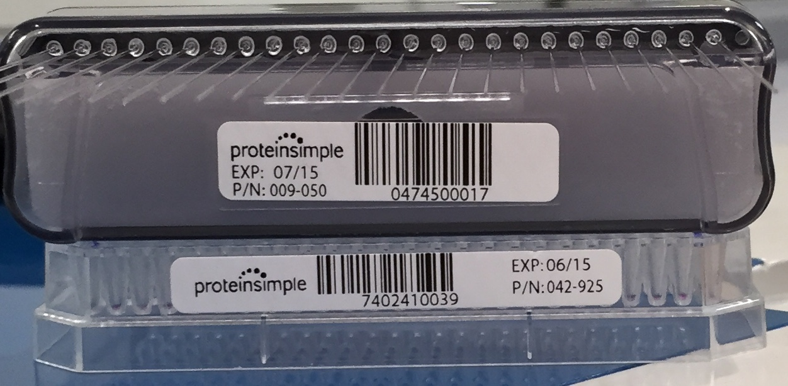
Example Cartridge Labels
Serial number in barcode
Expiration is month/year
10 digit serial number encodes manufacturing information

Slide 7
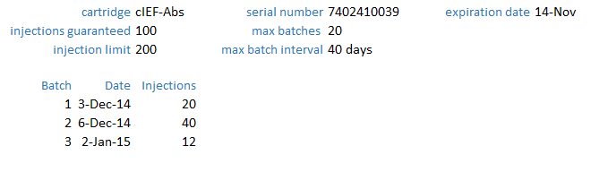
Kompass
Displays the tag information for the currently installed cartridge and in each run file

Slide 8
Run Errors
Runs are flagged as out of specification for the following reasons:
Past the expiration date
More than the guaranteed injection count
More than the max number of batches
Greater than the max period between injections
The instrument will refuse to run:
Cartridge types not supported by the instrument
Wrong assay for the cartridge type
Any injections past the injection count limit
Size injections past the gel injection count

Slide 9
Larger Tag Memory
The 128 byte tag is limiting
More memory could store:
The instrument ID with each batch
The user ID for each batch
More than 20 batches

